Slide 1
CS-2001 Data Structures
Advanced Sorting Algorithms

Slide 2
Merge Sort
Merge Sort Algorithm is a Divide & Conquer algorithm. It divides input array in two halves, calls itself for the two halves(recursively) and then merges the two sorted halves. A separate merge() function is used for merging two halves.
Time Complexity: O(n*log(n))
Space Complexity: n

Slide 3
Merge Sort - Continue
There are 3 Phases in the Merge Sort Algorithm
Division Phase : Divide the array into 2 halves by finding the mid of the array.
Mid (m) = (left + right)/ 2
left is the starting index & right is the last index of the array
Recursion Phase
Call Merge Sort on the left sub-array
Call Merge Sort on the right sub-array
Merge Phase
Call merge function to merge the divided sub-arrays back to the original array.
Perform sorting of these smaller sub arrays before merging them back.

Slide 4
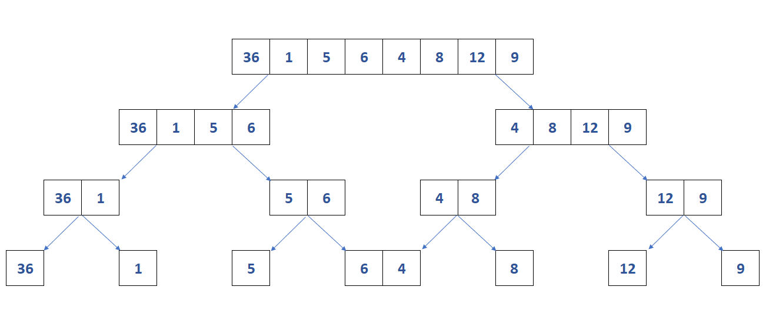
Merge Sort- Division

Slide 5
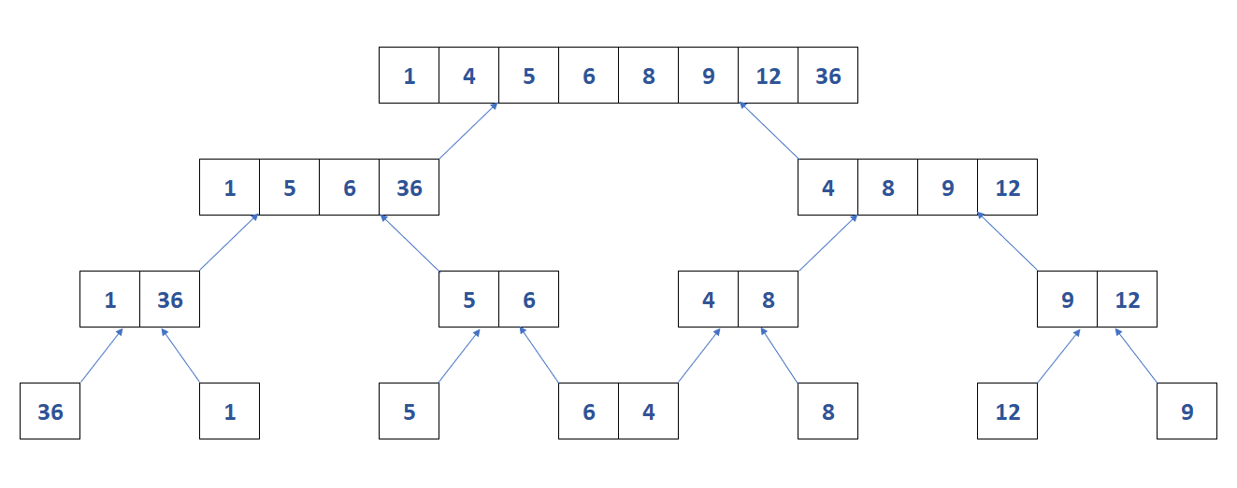
Merge Sort- Merging

Slide 6
Merge Sort - Algorithm
mergeSort(arr[],l,r)
{
if(l<r)
{
midpoint = (l+r)/2
mergeSort(arr,l,m)
mergeSort(arr,m+1,r)
merge(arr,l,m,r)
}
}

Slide 7
Merge Sort
Advantages
It is quicker for larger lists because unlike insertion and bubble sort it doesnt go through the whole list seveal times.
It has a consistent running time, carries out different bits with similar times in a stage.
Disadvantages
Slower comparative to the other sort algorithms for smaller tasks.
uses more memory space to store the sub elements of the initial split list.

Slide 8
Quick Sort
Quick Sort Algorithm is a Divide & Conquer algorithm. It divides input array in two partitions, calls itself for the two partitions(recursively) and performs in-place sorting while doing so. A separate partition() function is used for performing this in-place sorting at every iteration.
Time Complexity: θ(nlog(n))
Space Complexity: O(log(n))

Slide 9
Quick Sort - Continue
There are 2 Phases in the Quick Sort Algorithm.
Division Phase – Divide the array into 2 halves by finding the pivot point to perform the partition of the array.
The in-place sorting happens in this partition process itself.
Recursion Phase –
Call Quick Sort on the left partition
Call Quick Sort on the right partition.

Slide 10
Quick Sort - Algorithm
Quick Sort Algorithm
Quick Sort Partition Function
QuickSort(arr[], s, e)
{
if(s<e)
{
p = Partition(arr[],s,e)
QuickSort(arr[], s, (p-1))
QuickSort(arr[], (p+1), e)
}
}
Partition(arr[], s, e)
{
pivot = arr[e]
plndex=s
for (i=s to e-1)
{
if(arr[i]<=pivot)
{
swap(arr[i], arr[pIndex])
plndex++
}
}
swap(arr[e], arr[plndex])
return pIndex
}

Slide 11
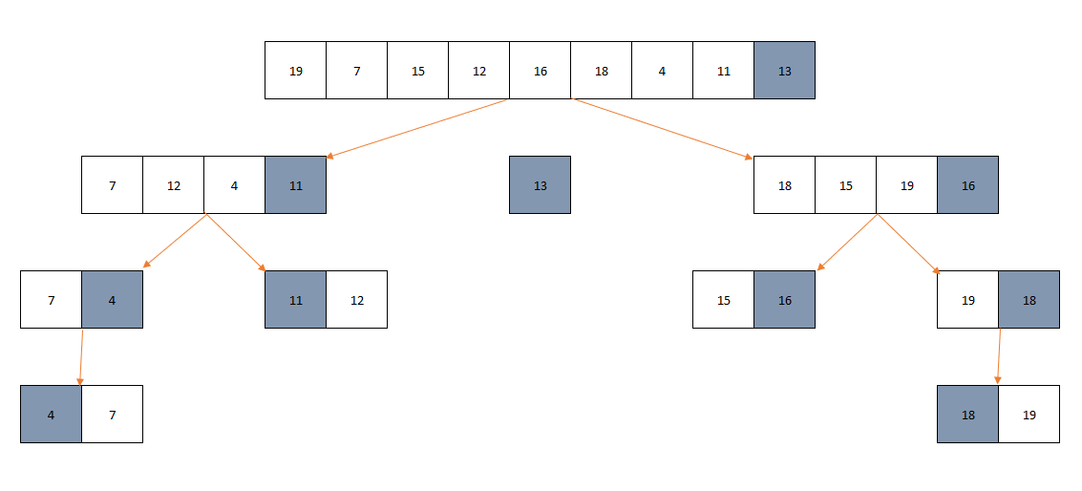
Quick Sort - Working

Slide 12
Quick Sort
Advantages
It is in-place since it uses only a small auxiliary stack.
It requires only n (log n) time to sort n items.
It has an extremely short inner loop.
Disadvantages
It is recursive. Especially, if recursion is not available, the implementation is extremely complicated.
It requires quadratic (n²) time in the worst-case.

